Slide 1
CHALLENGE 5 Steering the Car
Group 3
Aoshuang wang, lan yao, yixuan huang, lan luo

Slide 2
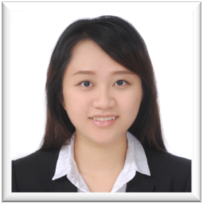
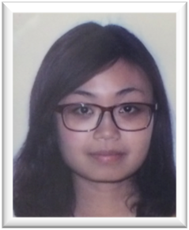
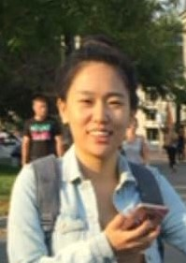

 | Lan Yao | Aoshuang Wang | Yixuan Huang | Lan Luo
Challenge 1 | Presenter
Challenge 2 |  |  | Presenter
Challenge 3 |  | Presenter
Challenge 4 |  |  |  | Presenter
Challenge 5 | Presenter
Challenge 6
Challenge 7
Challenge 8

Slide 3
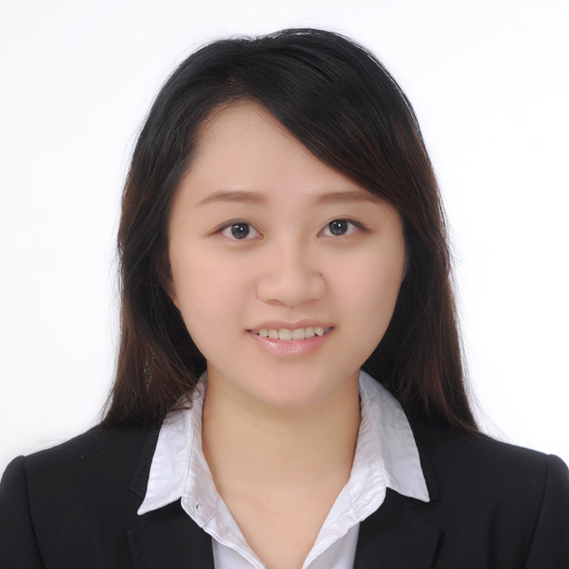
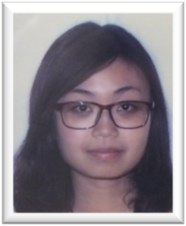
 | Lan Yao | Aoshuang Wang | Yixuan Huang | Lan Luo
 | Program Writing (assess the situation) Configure Component Parameter | Program Writing (PID / assess the situation/html) Configure Component Parameter | Hardware Access Configure Component Parameter | IOS App Design & Control Program Writing (assess the situation) Configure Component Parameter

Slide 4
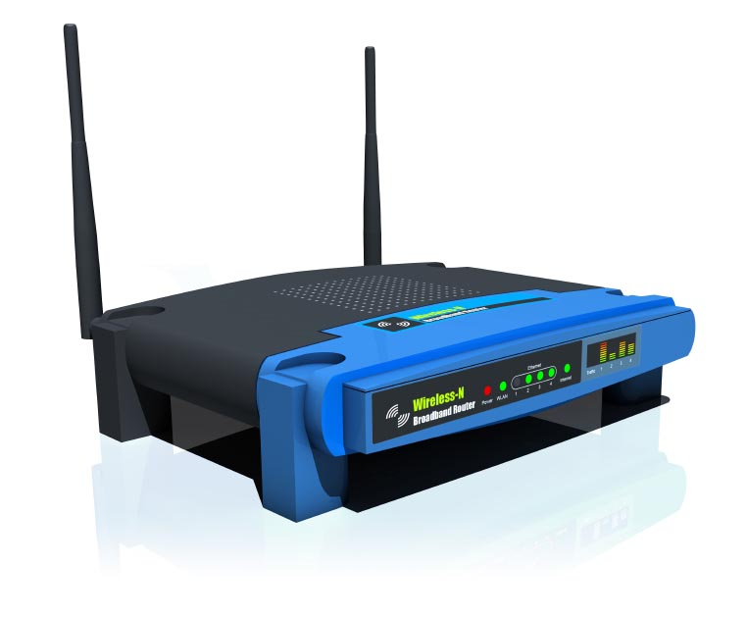
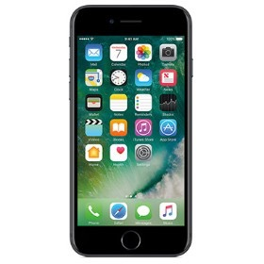
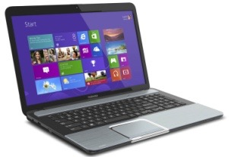
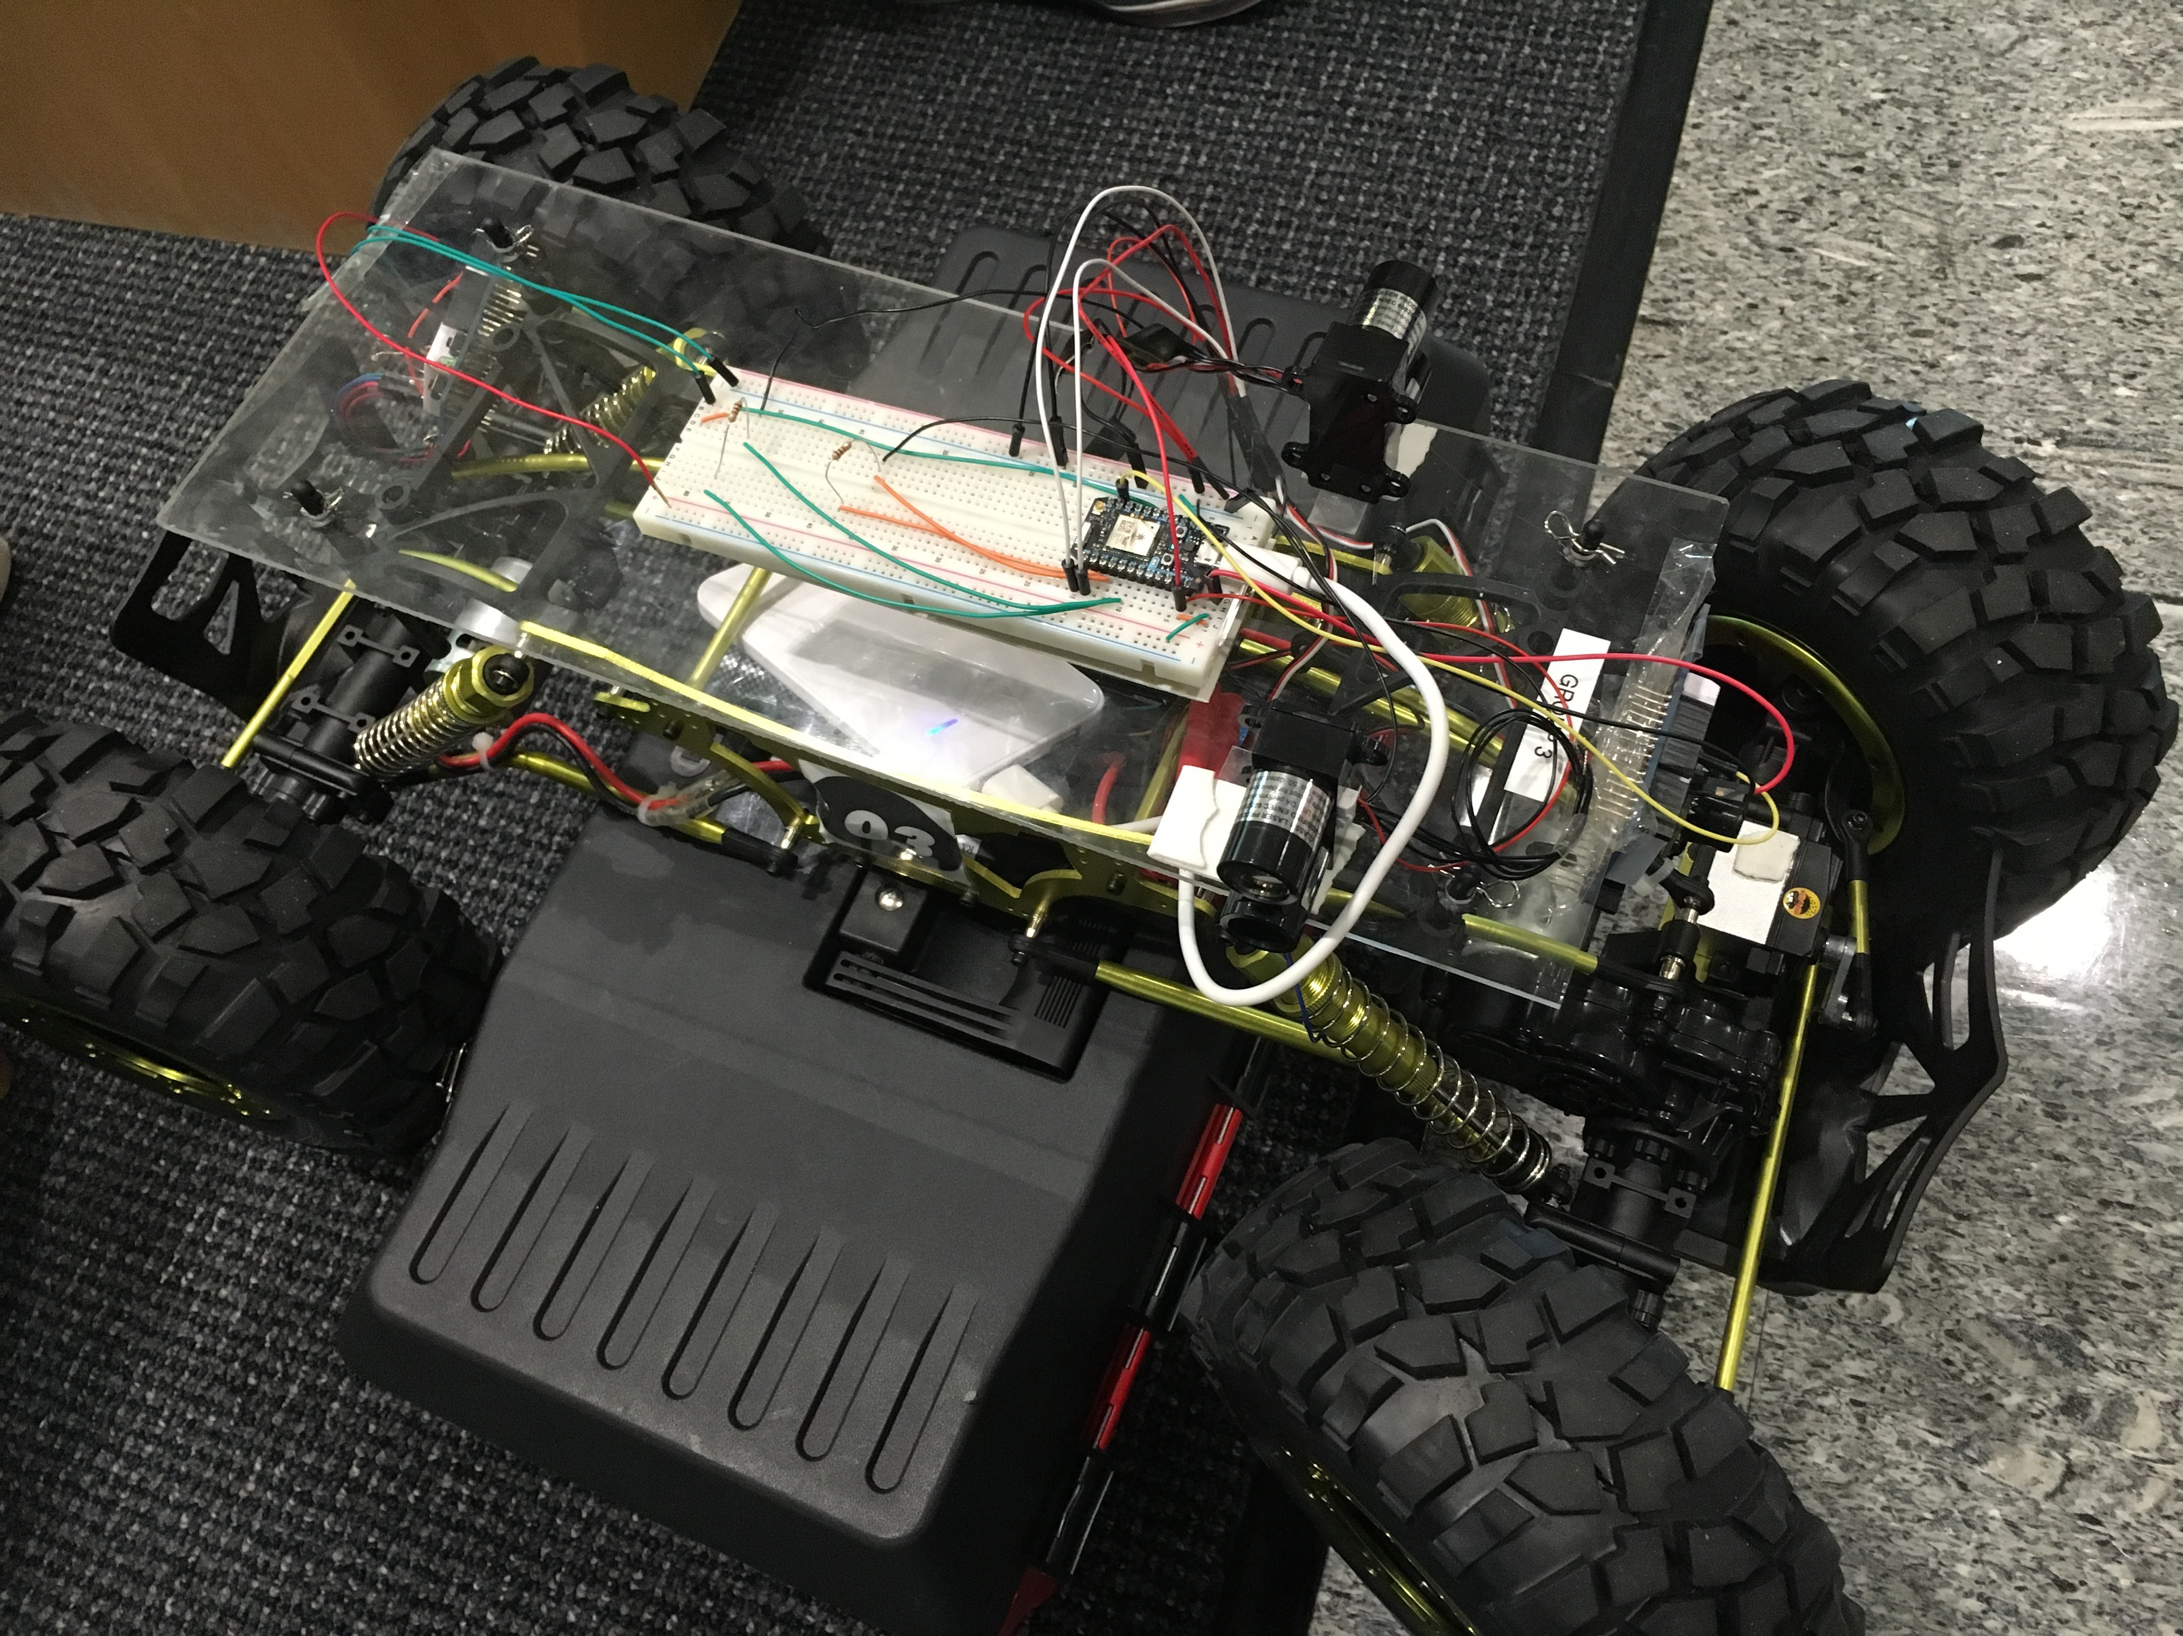
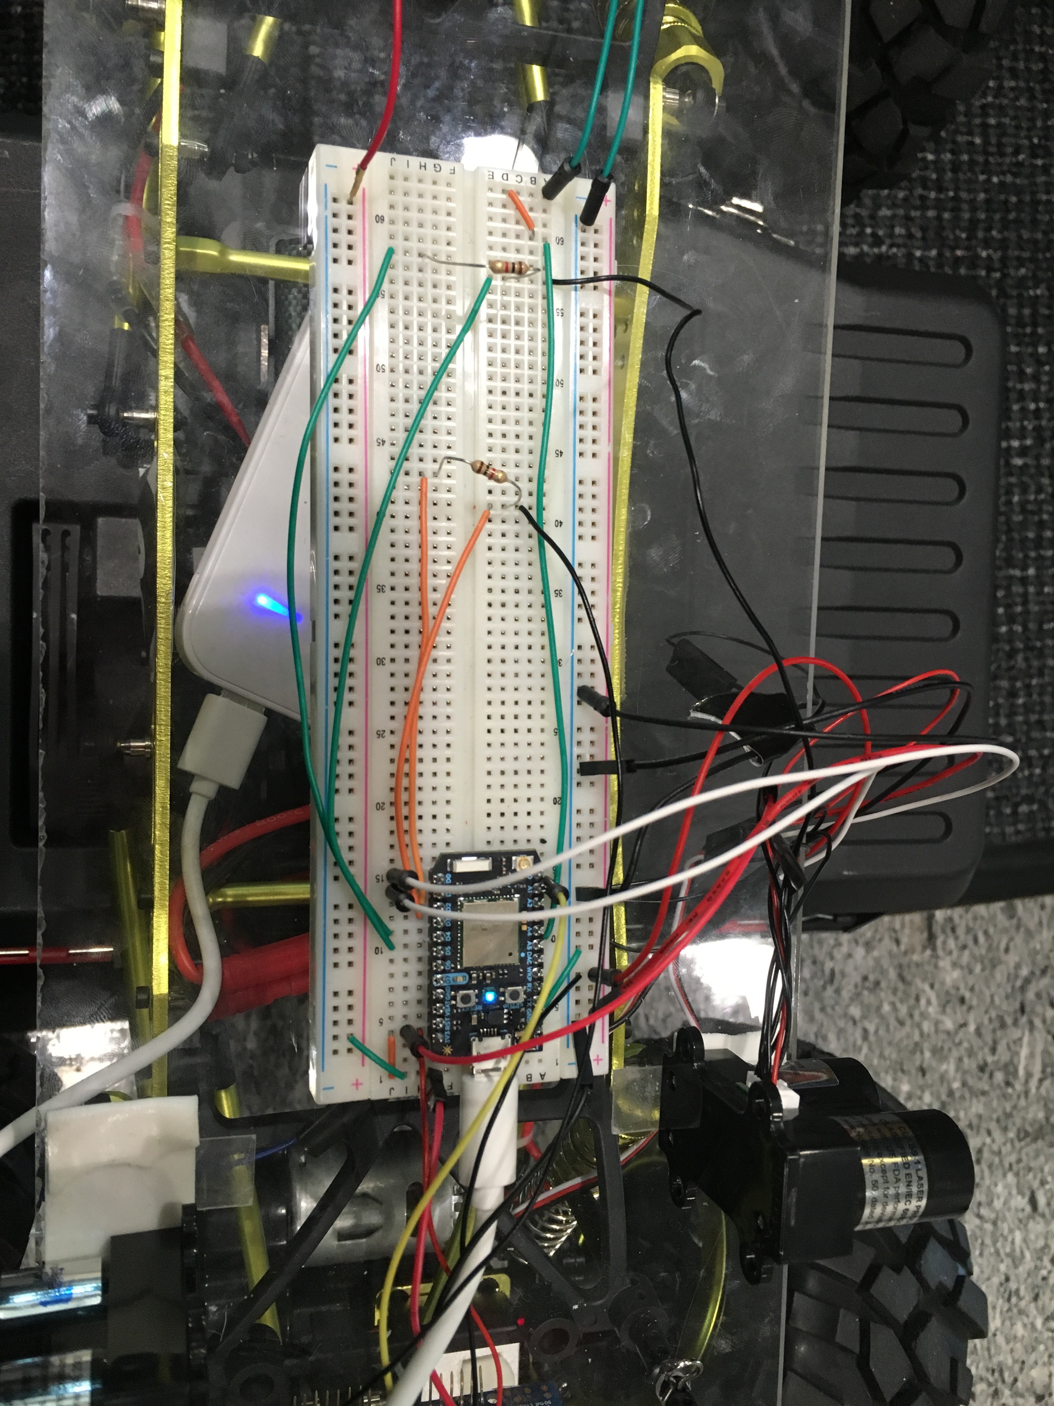
Devices
Laptop
Router
Phone
Auto-Car
Photon

Slide 5
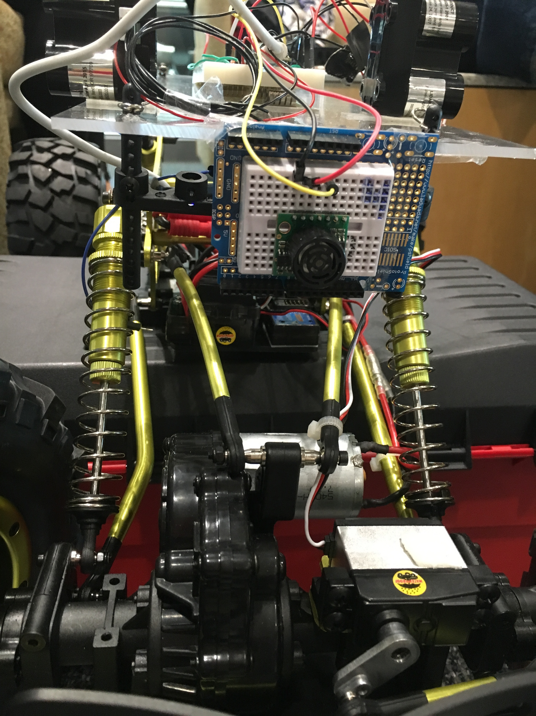
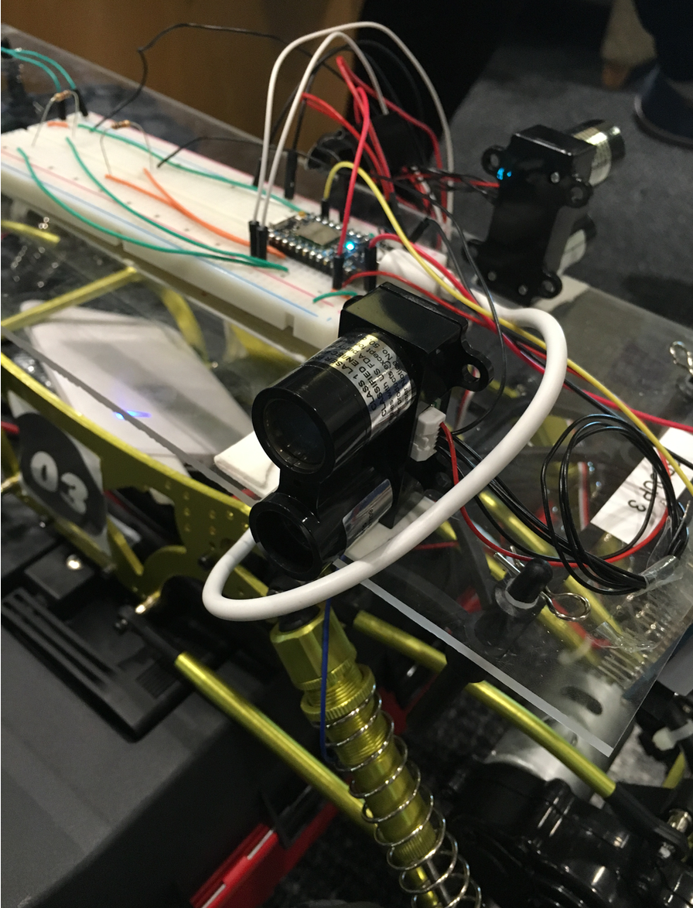
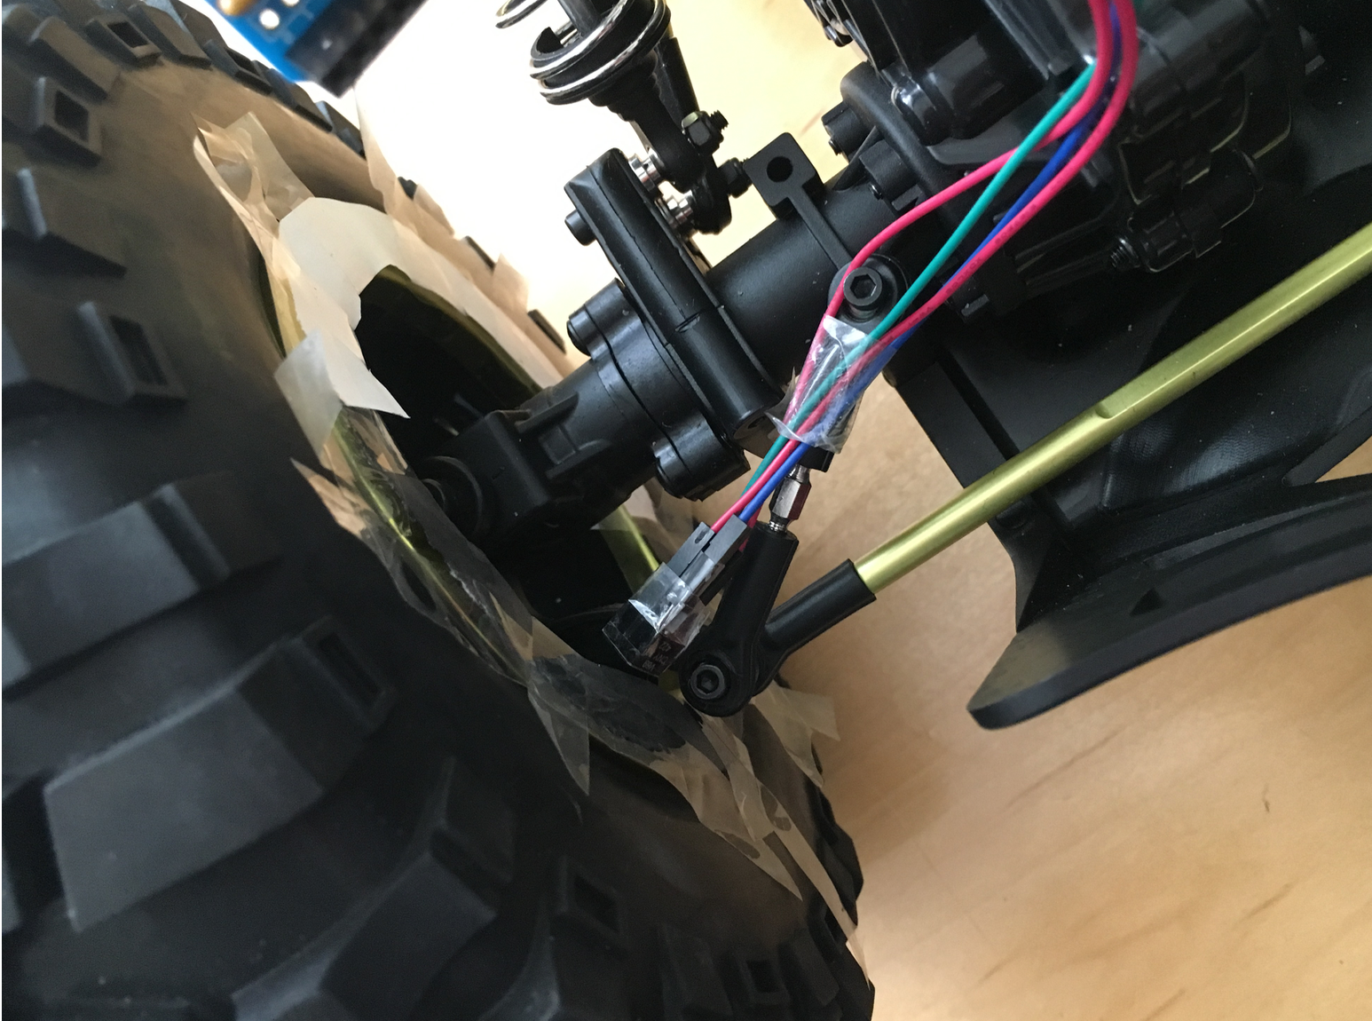
Sensors
Sonic (Front)
Lidar * 1
(one side)
Speed sensor (right beside wheel)
Distance Sensor

Slide 6
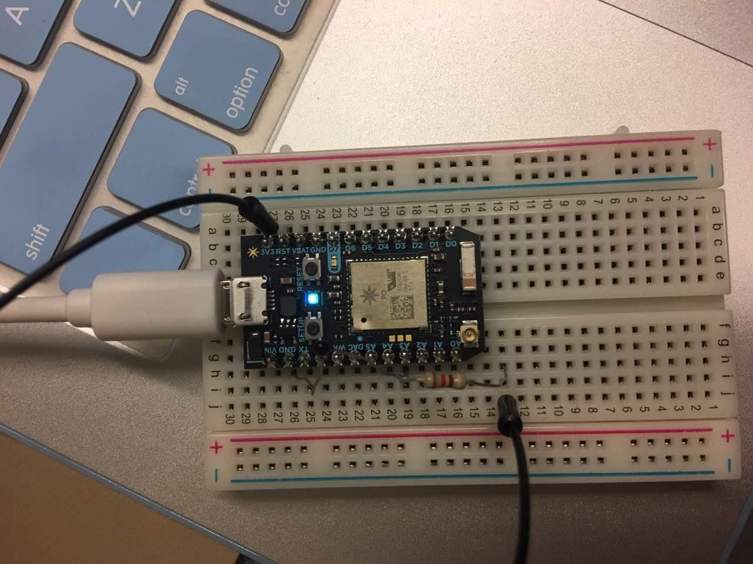
Main Architecture
Particle
Photon
Controls
Wheels (direction)
ESC (speed)
Distance/speed Sensors

Slide 7
Data structure
if: Dist (Sonic) < 100: speed down: esc.write(90)
if: Dist (Sharp1) <70: PID Sharp1 to 50: wheels.write(90 + pid output)
(elif: Dist (Sharp2) < 70: PID Sjarp2 to 50: wheels.write(90 - pid output))

Slide 8
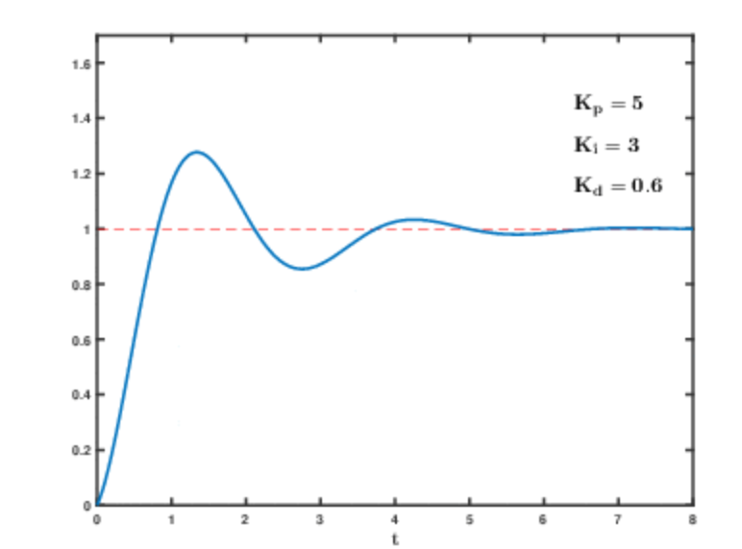
Design Details
PID:
Setpoint (desired output),
Input (real data),
Output (applied data through PID)

Slide 9
What we have done sensor
Lidar (distance sensors):
Two lidars: left and right
When Lidar1 distance < 70 (situation that lidar1 side has a gap on the wall -> PID Lidar2
When Lidar2 distance < 70 (situation that lida2 side has a gap on the wall ->PID Lidar1
Control the direction of auto car

Slide 10
What we have done sensor
Sonic (distance sensors):
One sensor: front
When sensor distance < 100: there is an obstacle in front of the car, the car needs to stop
PID ESC to 90 (stop)
Control the stop and run

Slide 11
What we have done html

Slide 12
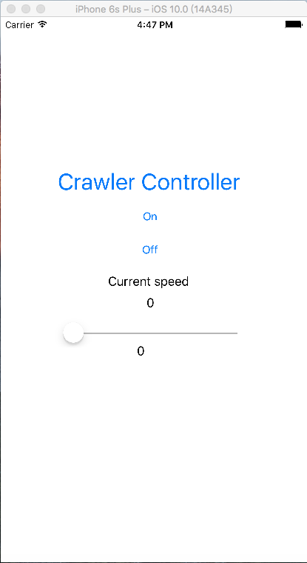
What we have done app

Slide 13
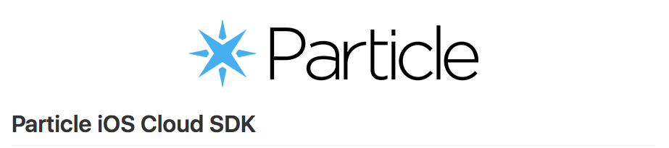
Library:
Particle iOS Cloud SDK
Particle iOS Cloud SDK enables iOS apps to interact with Particle-powered connected products via the Particle Cloud. It’s an easy-to-use wrapper for Particle REST API.

Slide 14
CALL A FUNCTION ON A PARTICLE DEVICE
SET ‘ON’ TO RUN CRAWLER
AND
SET ‘OFF’ TO STOP CRAWLER
LOGGING IN TO PARTICLE CLOUD
GET A LIST OF ALL DEVICES
CHOOSE THE DEVICE TO CONNECT
CHANGE SPEED OF CRAWLER
SUBSCRIBE TO EVENTS:”SPEED”
GET SPEED OF CRAWLER

Slide 15
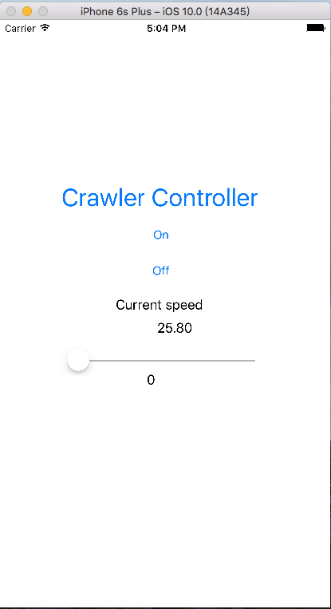
GET SPEED OF CRAWLER
SparkEventHandler handler = ^(SparkEvent *event, NSError *error) {
if (!error)
{
dispatch_async(dispatch_get_main_queue(), ^{
NSLog(@"Got Event %@ with data: %@",event.event,event.data);
_speed.text=event.data;
});
}
else
{
NSLog(@"Error occured: %@",error.localizedDescription);
}
};
// This line actually subscribes to the event stream:
id eventListenerID = [[SparkCloud sharedInstance] subscribeToDeviceEventsWithPrefix:@"Speed1" deviceID:@"230044001547353236343033" handler:handler];
NSLog(@"%@",eventListenerID);

Slide 16
CODE IN PHOTON
int lightLED(String cmd) {
if(cmd == "ON") {
// digitalWrite(D7, HIGH);
which_command=1;
return 1;
}
else if(cmd == "OFF") {
// digitalWrite(D7, LOW);
which_command=2;
return 2;
}
}
switch (which_command) {
case 1:
esc.write(70);
// digitalWrite(aaa,HIGH);
which_command = 0;
break;
case 2:
esc.write(90);
// digitalWrite(aaa,LOW);
which_command = 0;
break;

Slide 17
SET ‘ON’ , ‘OFF’ AND CHANGE SPEED OF CRAWLER
NSURLSessionDataTask *task = [myPhoton callFunction:@"fun_test" withArguments:@[@"ON"] completion:^(NSNumber *resultCode, NSError *error) {
if (!error)
{
NSLog(@“Successful!!!”);
}
else
{
NSLog(@"wrong~~");
}
}];

Slide 18
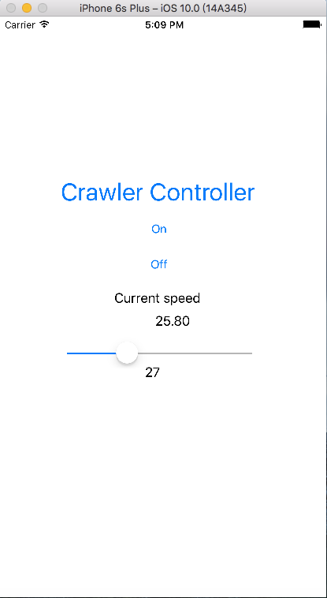
if(value1>20 && value1<=30)
{
NSURLSessionDataTask *changespeed3 = [myPhoton callFunction:@"fun_test1" withArguments:@[@"25"] completion:^(NSNumber *resultCode, NSError *error) {
if (!error)
{
NSLog(@“Successful!!!”);
}
NSLog(@"wrong~~");
}];
}

Slide 19
CODE IN PHOTON
switch (which_command) {
case 25:
esc.write(65);
// digitalWrite(aaa,HIGH);
which_command = 0;
break;
int speed(String cmd){
if(cmd == "25")
{
which_command=25;
return 25;
}

Slide 20
Challenges Encountered and Resolved sensor
Sensors easy to break:
We use two lidars at the beginning and so it will continue going straight forward even though there is a gap on one side. However, one of our lidars was broken, we have to use only one lidar which would not solve the problem of gap.

Slide 21
Challenges Encountered and Resolved sensor
Sensors accuracy:
The sensors’ accuracy needs to be improved if we want to make a right straight line traveling.

Slide 22
Challenges Encountered and Resolved particle
Flash problem:
When we were trying to flash our improved program into photon, there always was a time-out warning. We can only flash our code into photon successfully after we have tried hundreds of times and we are pretty sure that our photon and program are correct.

Slide 23
Challenges Encountered and Resolved HTML

Slide 24
Challenges Encountered and Resolved app
Long Delay of Call Function
It will cost a long time for our application and photon to finish call function(run, stop, and change speed of crawler).
Data change of UISlide too fast
Data of the UISlider changes so many times when we want to change the speed of crawler from original(ex. 60) to a new one(ex. 70), so that our photon could not response in time.

